Slide 1
Welcome to the INDIVIDUAL’S DAY
25th September 2015

Slide 2
What’s Happening Today
Time | Topic
9.45 | Introduction and Recap of Last Individuals Day
10.00 | Our New Website
10.30 | Tea/Coffee Break
11.00 | Christmas Party Update
11.30 | Opinions/Feedback
12.30 | Lunch
1.30 | Achievements
2.30 | Review of the Day and Finish

Slide 3
Last Individual’s Day in May 2015
Communication & Facilitator Changes – how was it going?
Health – Benefits of getting help with Health
What’s Working – How things are going?
Notes:
Communication & Facilitator Changes - Were the changes working well? Etc.
Feedback to figure out What’s Working - General thoughts as to how things are going
Health Management with Anthony & Justin - Benefits of support focused on Health
Life Coaching with Liam & Deirdre - What life coaching is and how it can help people achieve their goals
Self Reflections with Community Facilitators & Helen - What is self reflection and why it is important
Family Support with Community Facilitators - How can we improve family support

Slide 4
Last Individual’s Day in May 2015 2
Life Coaching – What is it and How it can Help?
Family Support – How can we make it better? - CFs
Self Reflection – What is it and Why it’s Important?

Slide 5
Cumas.ie Our New Website

Slide 6
Cumas.ie – Our New Website
Contacted WIT Summer 2014 for Web Design Students
Eamon Barron & Kevin Brown – September – December 2014
Website Team took over from January – meeting often to finish website
Due to be launched end of September

Slide 7
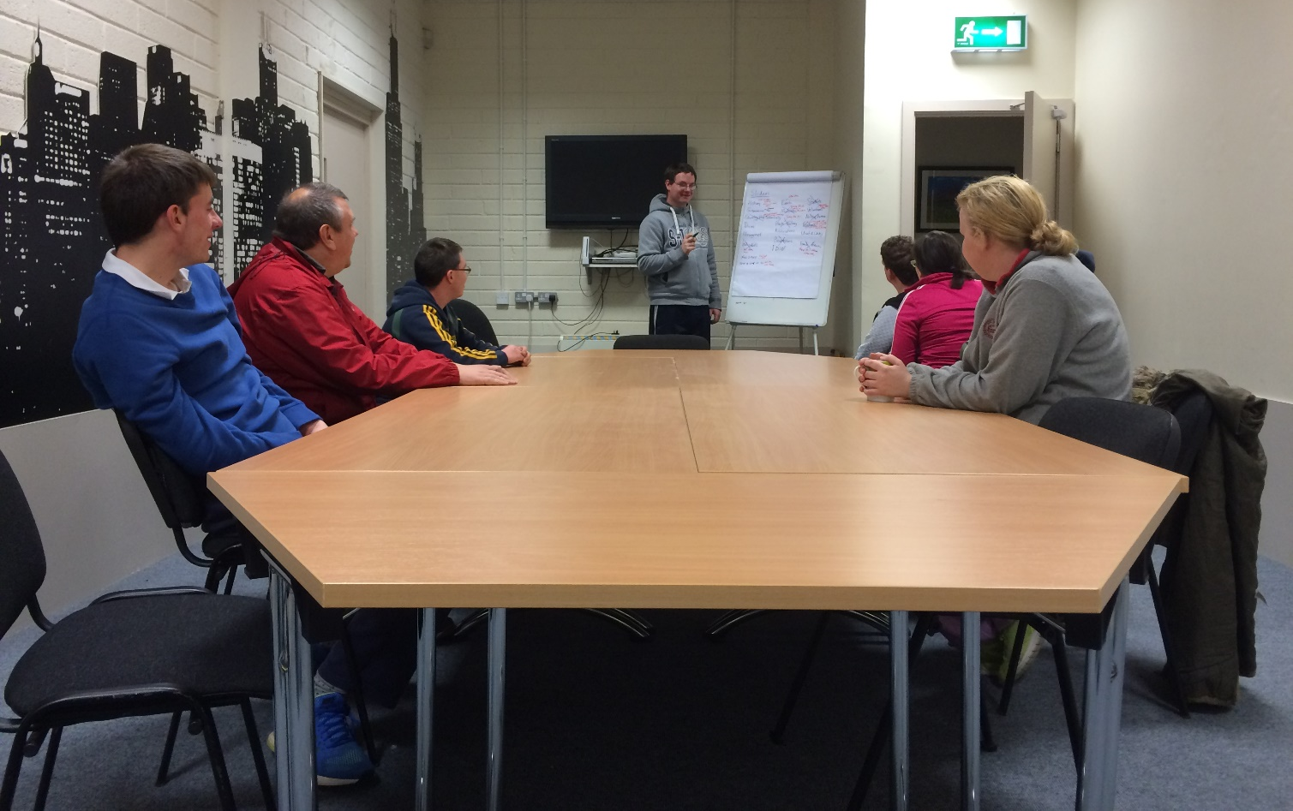
Cumas.ie – The Team
Murty Browne
Damien Phelan
Colm McEvoy
Bridget Sinnott
Mary Sinnott
Chelsea Flynn
Thomas Murray
Diarmuid Byrne
Shane Purcell
Noel Kehoe
Justin Crowdle
Shannon O’Farrell Molloy
Aoife Kavanagh

Slide 8
Cumas.ie – Some Key Elements
Individual’s Blogs to Share Personal Experiences etc.
A different feel to other websites
Show the really important people in Cumas – You!
Provide space for families – Family Forum
Source of Information about Cumas for Everyone
To display people’s talents, projects, work etc.
To show people what we do

Slide 9
Cumas.ie – What it Looks Like

Slide 10
Cumas.ie – What it Looks Like 2

Slide 11
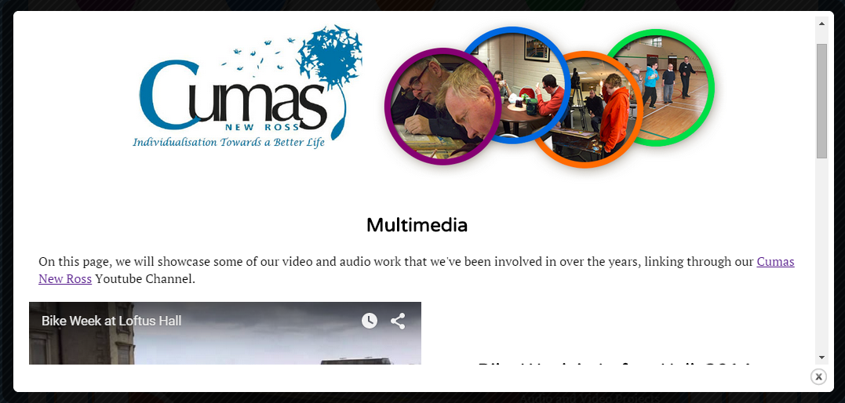
Cumas.ie – What it Looks Like 3

Slide 12
Cumas.ie – What it Looks Like 4

Slide 13
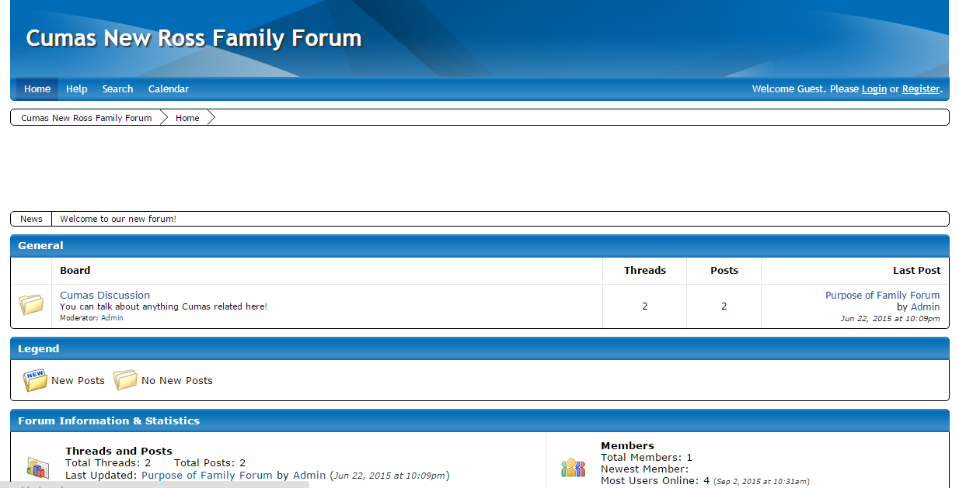
Cumas.ie – What it Looks Like 5

Slide 14
Thank you for Listening
Time for Tea Break

Slide 15
Christmas Party 2015 Update

Slide 16
What Date?
Majority of People said 4th December

Slide 17
Where is it?
Majority of People chose Horse & Hound

Slide 18
What type of Music?
Majority of People chose a Band

Slide 19
Music?
Majority of People chose El Paso

Slide 20
Food – Two Options
Option 1 – 3 Course Meal and Band, Ticket Cost €26.00
Starter – Soup
Main Course – Turkey & Ham
Dessert – Christmas Pudding

Slide 21
Food – Two Options
Option 2 – 3 Course Meal with Choice on Menu and Band, Ticket Cost €29.00
Starter – Soup or Vol Au Vent
Main Course – Turkey & Ham or Salmon
Dessert – Christmas Pudding or Trifle/Apple Tart

Slide 22
Break into Groups with your Facilitators
Choose Option 1 or
Option 2 for Food

Slide 23
Opinions and Feedback

Slide 24
Opinions and Feedback
Looking for thoughts on how things are going?
What do you think about the Individuals Day?
Do you drink Tea or Coffee?
Are you happy working with your facilitator/community facilitator?
What would make us better?
And More………..

Slide 25
Peer Mentoring
Helping other Individuals learn new skills that you already know
Example: if you can play keyboard then you might like to help other people learn.
To be discussed in feedback sessions

Slide 26
Break into Groups with your Community Facilitators

Slide 27
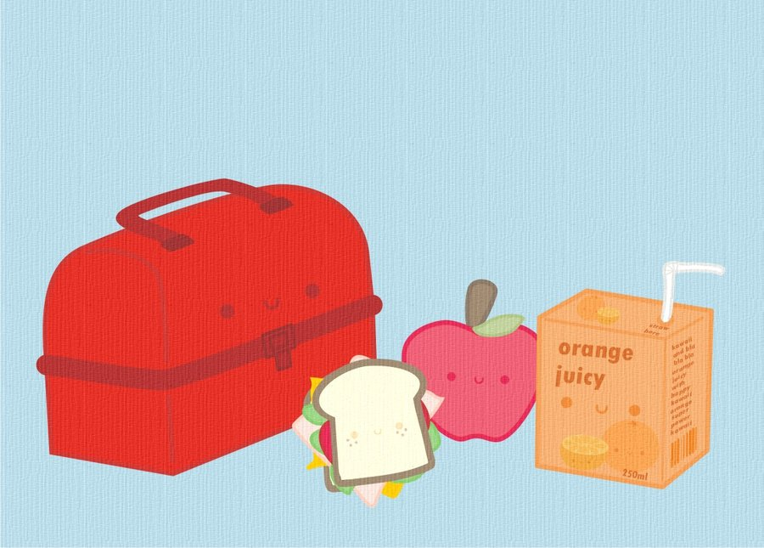
Lunch

Slide 28
Achievements

Slide 29
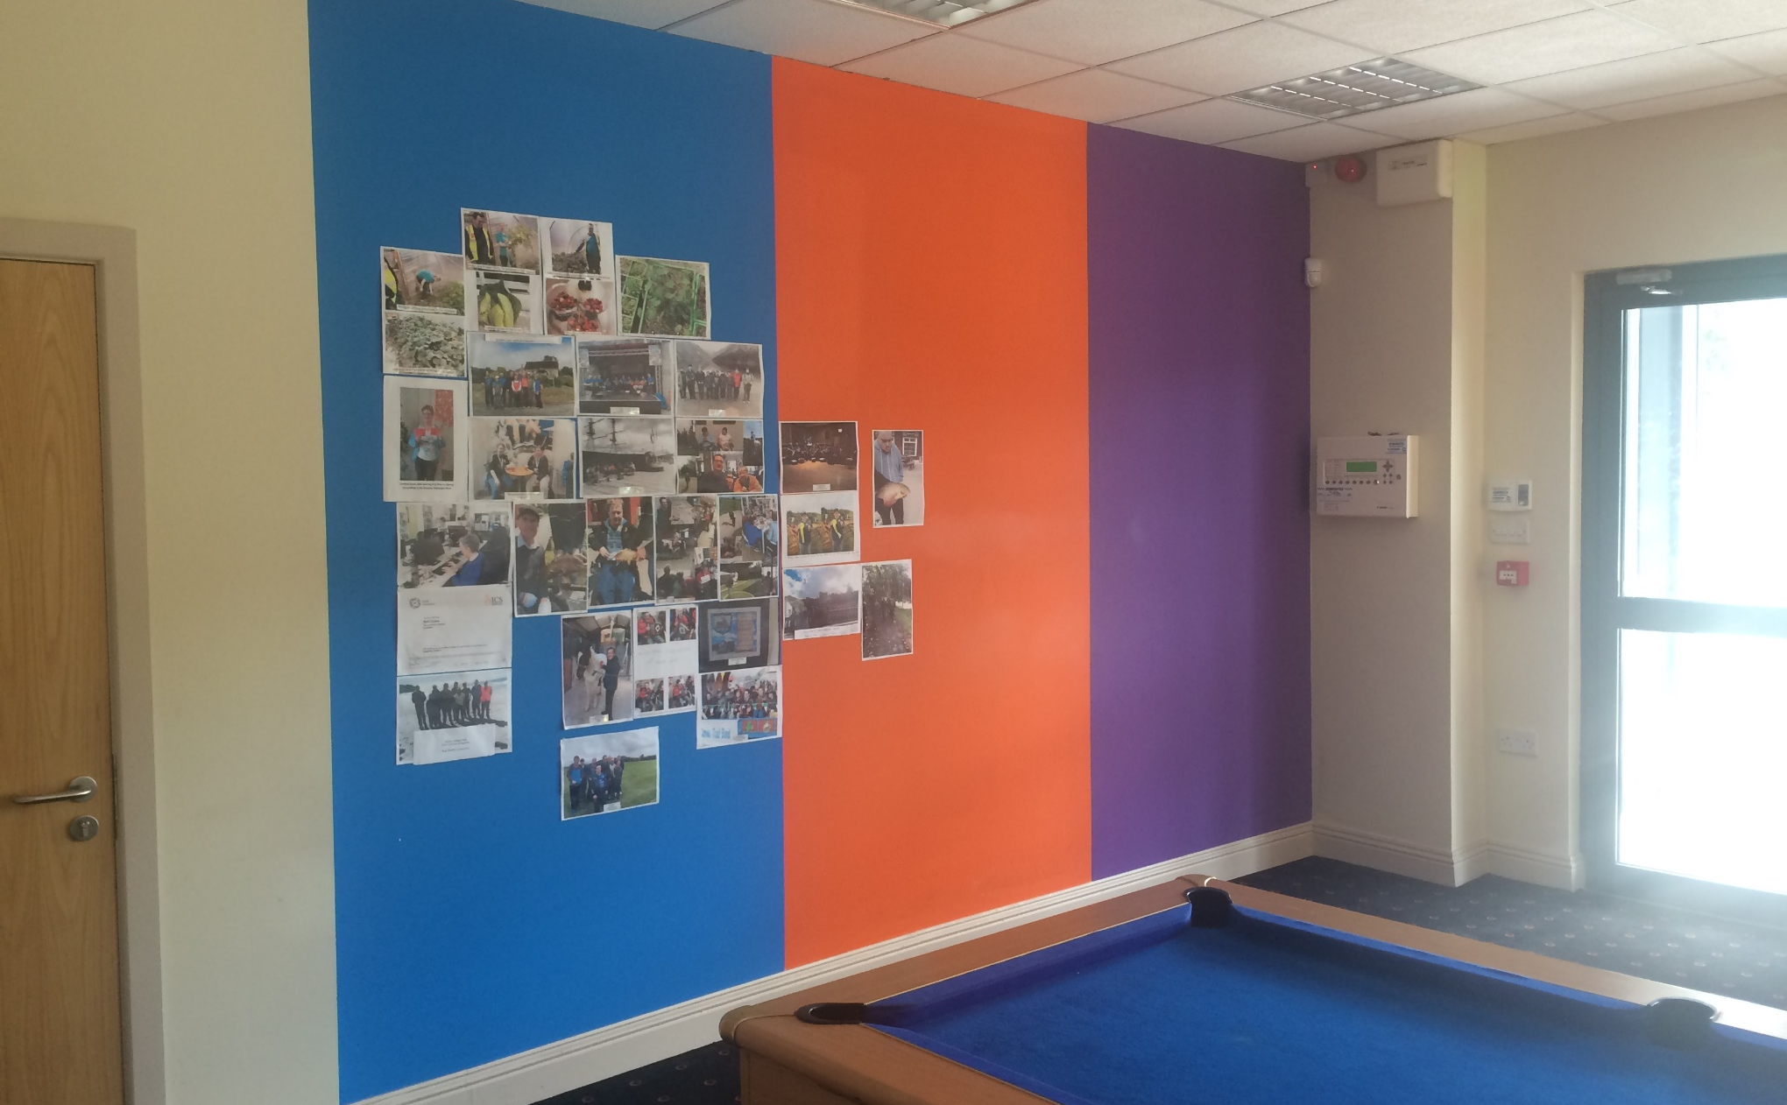
Achievements

Slide 30
Achievements - Thomas

Slide 31
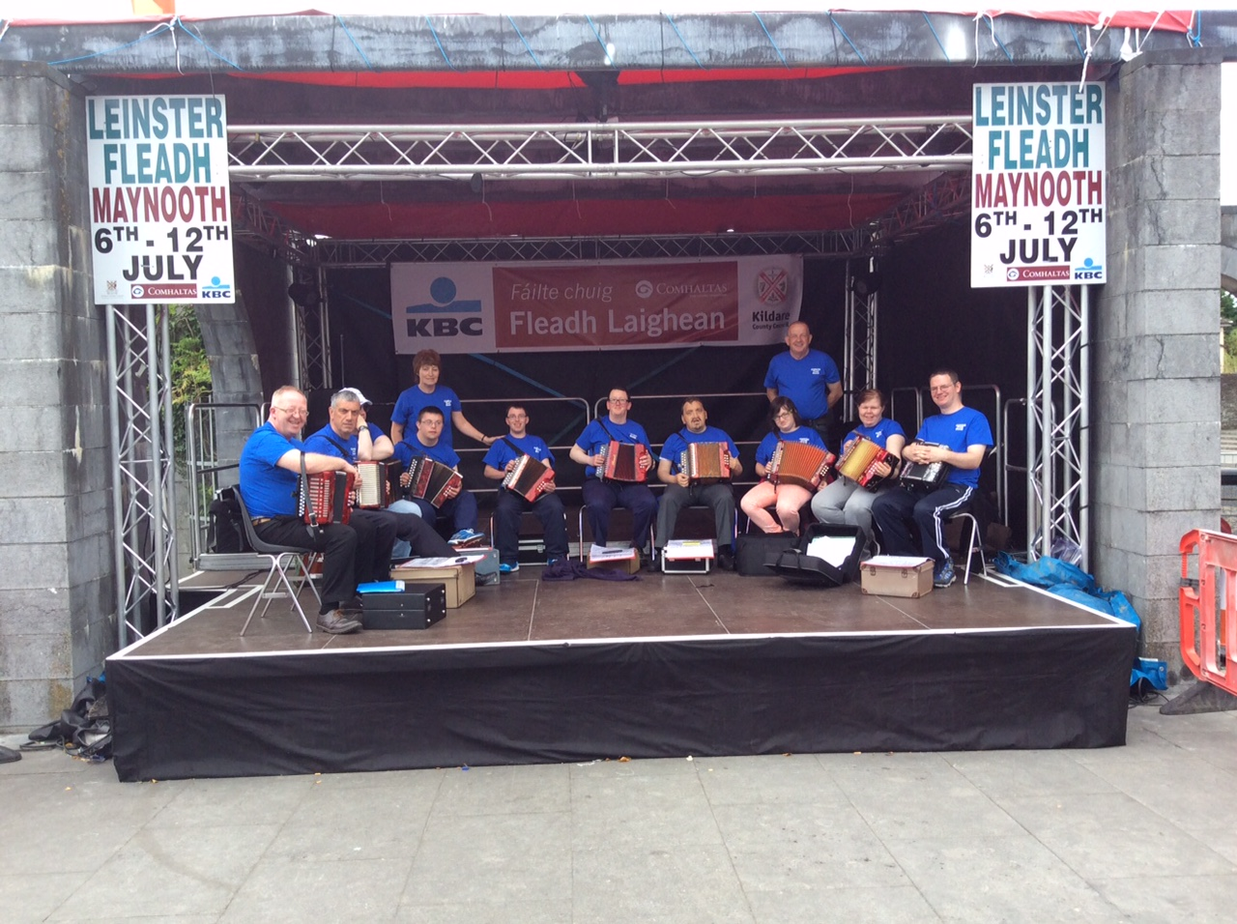
Since the last Individual’s Day…… 13
Cumas Trad Band
- Played on the Main Stage at the Leinster Fleadh Ceoil in Maynooth

Slide 32
Review of the Day

